Slide 1
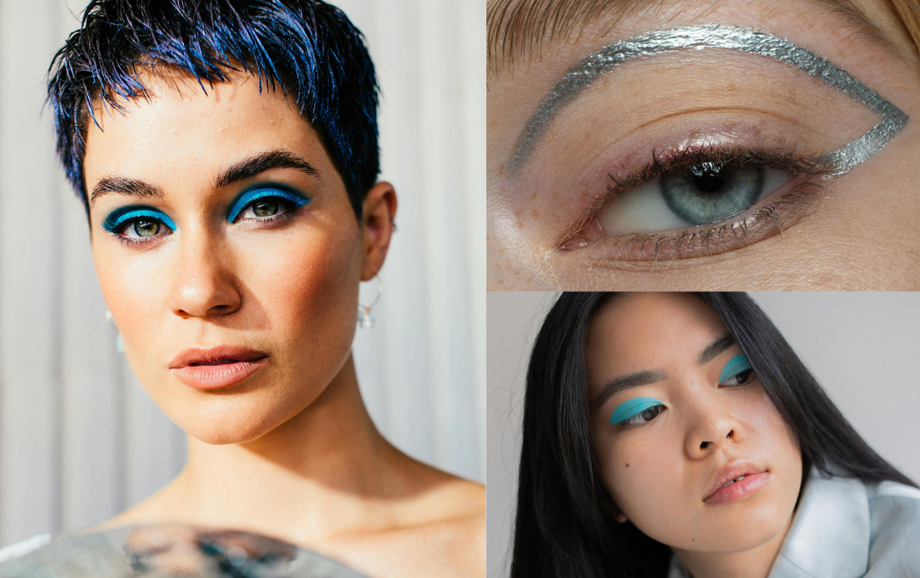

You Are #Bluetiful with Estée Lauder
💙 Discover the Joy of Blue: Embrace the Resurgence of Blue Makeup! 💙​
Currently staging a fabulous comeback, blue hues have been dominating runways and red carpets since the beginning of 2024. Don't be intimidated by blue - anyone can rock a blue makeup look with the right application technique and a shade that complements their skin tone. ​
​
So, join us in diving headfirst into this #BlueMakeup movement, and let's explore just how versatile and enchanting this trend can be!

Slide 2

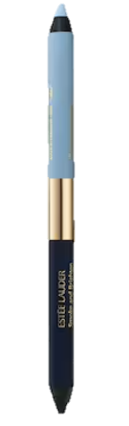
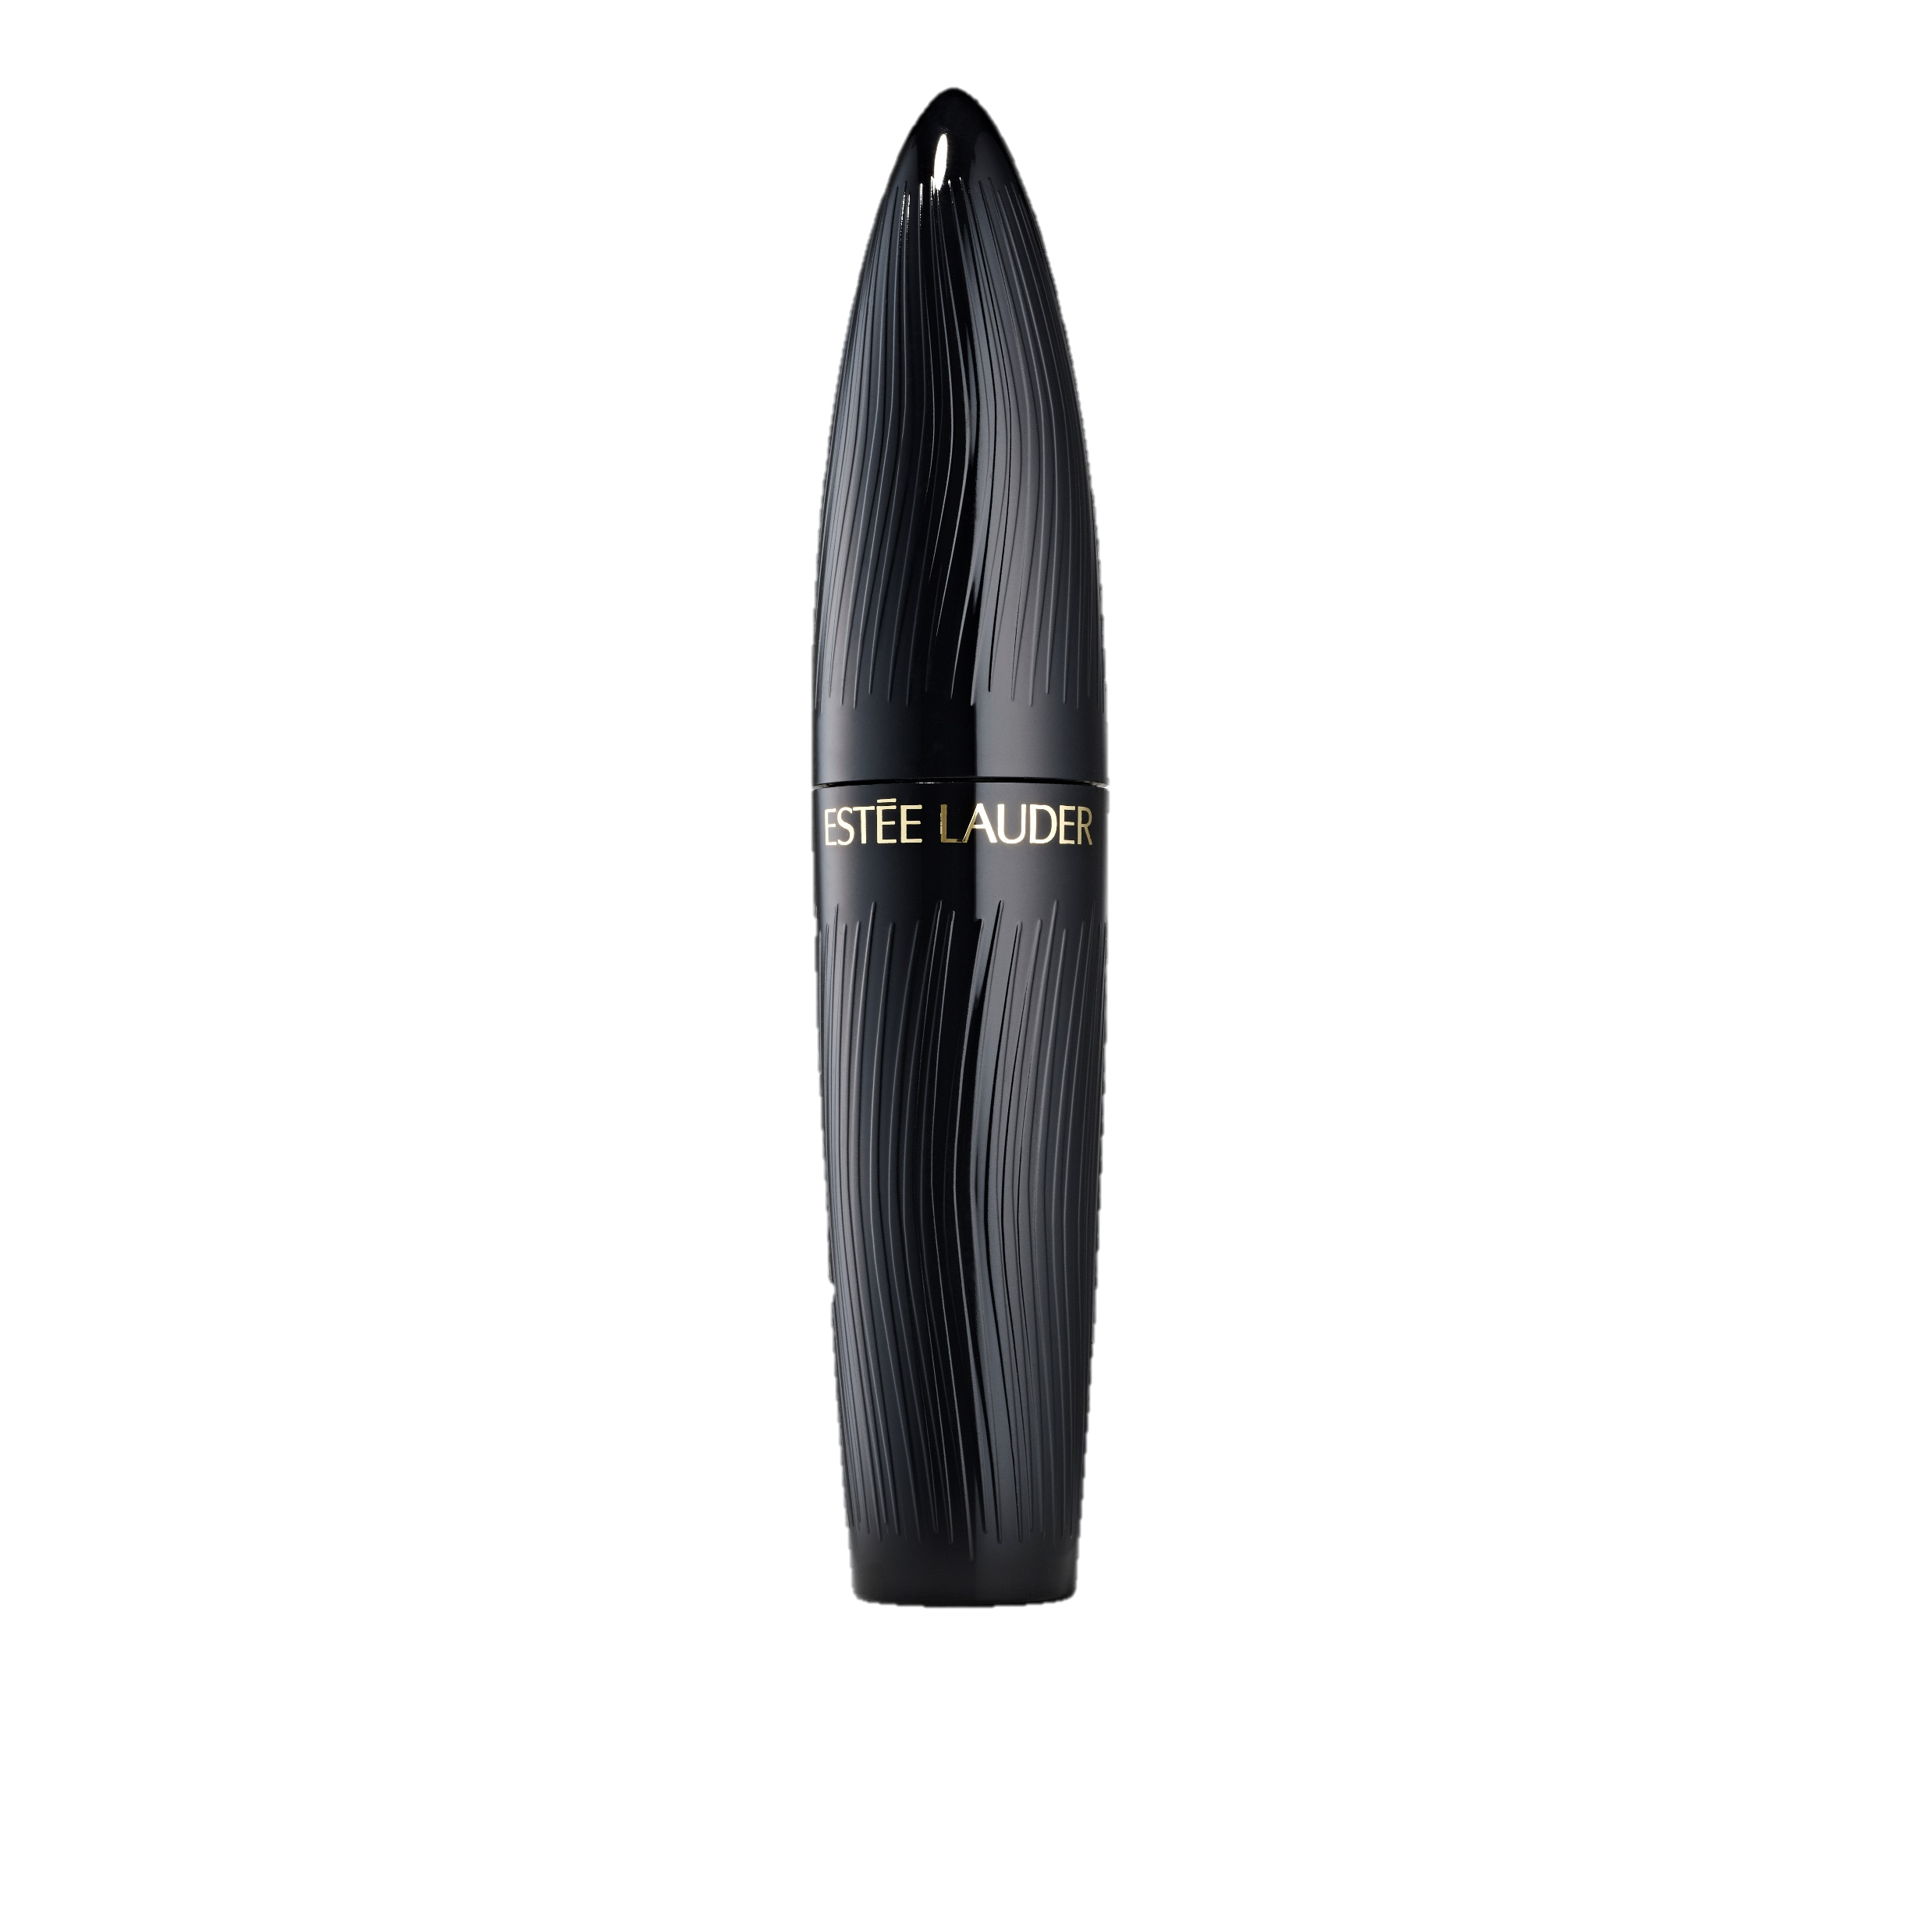
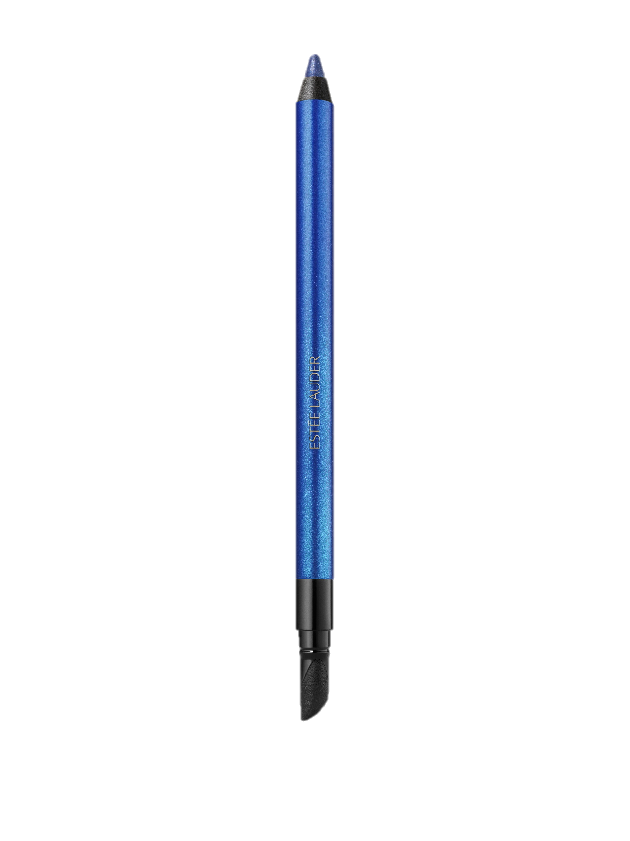
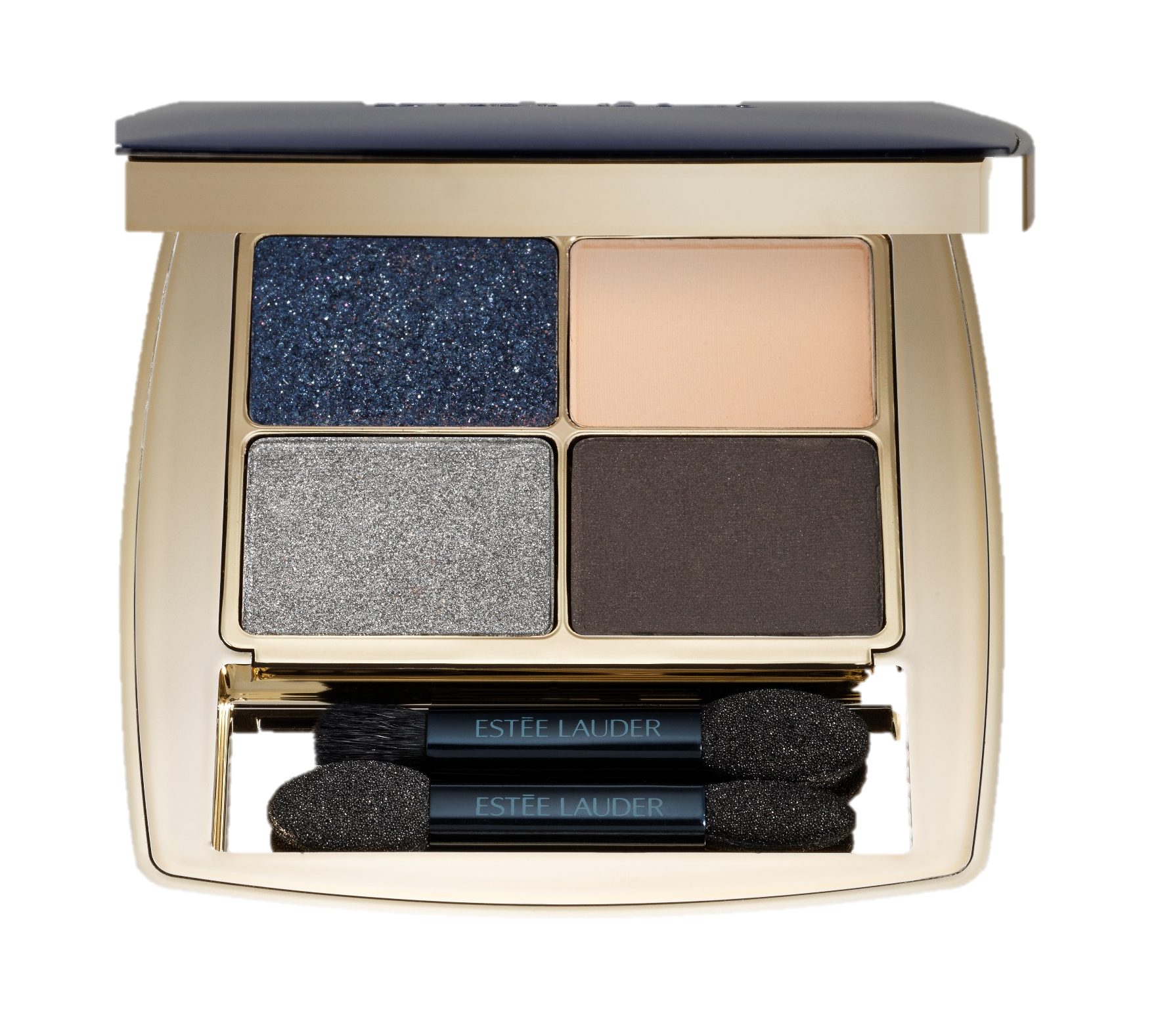
HOW TO GET THE LOOK?
Kajal Eyeliner Duo Smoke and Brighten in shade Marine / Sky Blue
Line, define and create eye-opening looks with this dual-ended creamy pencil featuring two beautiful blue contrasting high-impact hues.
Available via www.esteelauder.be
Suggested Retail Price €34
Turbo Lash High-Powered Mascara in Black
Builds long, full volume to your lashes, to get your most dramatic lash-look while nourishing and conditioning for visibly restored lashes that look thicker and healthier.
Available in all Estée Lauder point of sales
Suggested retail price €39 ​
Double Wear Crayon Gel Waterproof Tenue 24H in shade Sapphire Sky
This easy-to-apply gel pencil glides on without ever tugging or dragging. Sets in seconds to become waterproof and smudgeproof.
Available in all Estée Lauder point of sales
Suggested Retail Price €29
For more information contact mwauters@be.clinique.com
Pure Color Envy Luxe Eyeshadow Quad in shade Indigo Light
Take the guesswork out of crafting the perfect eye look. From matte to sparkle, these soft formulas glide on effortlessly for easy blendability, providing lasting, flawless wear.
Available in all Estée Lauder point of sales
Suggested Retail price €64

